Slide 1
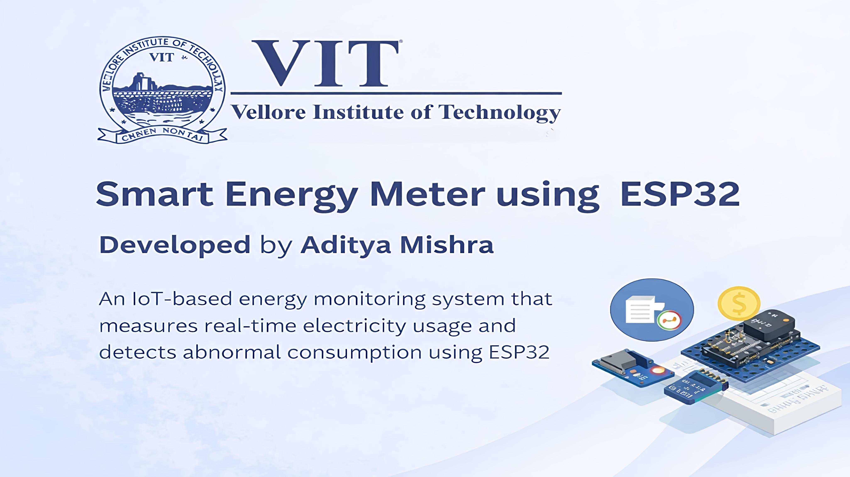

Slide 2
CONTENTS
Introduction
Motivation
Description of Project / Methodology Followed
Results & Discussion
Conclusion
References

Slide 3
INTRODUCTION
The internet of things (IoT) describes the network of physical objects that are embedded with sensors, software and other technologies for the purpose of connecting and exchanging data with other systems over the internet.
An Energy meter is a device, which is used for measuring the energy utilized by the electric load. This energy is basically the total power consumed by the load at a particular interval of time.

Slide 4
MOTIVATION
Electricity thefts are increasing every year across domestic as well as industrial domains which affect the economic status of the country.
Due to the lack of infrastructure, various wireless communication systems, though available, are not employed.
The project’s aim is to design a system to monitor the power consumed by load and to detect and eliminate the power theft in energy meters.

Slide 5
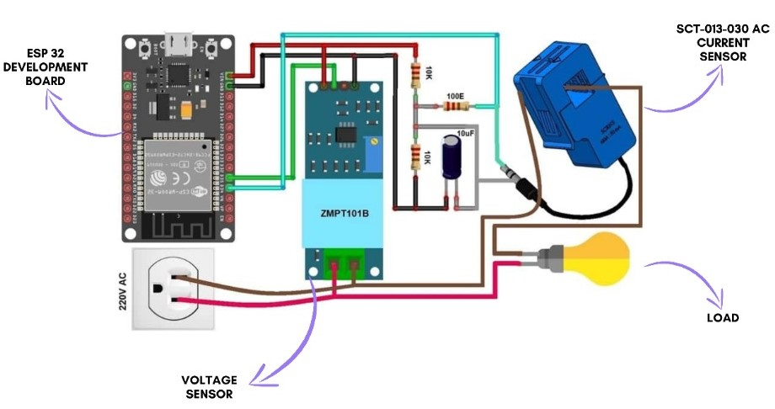
DESCRIPTION OF PROJECT/METHODOLOGY FOLLOWED

Slide 6
Components used :
ESP32 Development Board
ZMPT101B AC Single Phase Voltage Sensor
SCT-013 Current Sensor
10k Ω Resistors
100Ω Resistor
10μF Capacitor
Bread Board
Jumper Wires
Bulb
3-pin plug

Slide 7
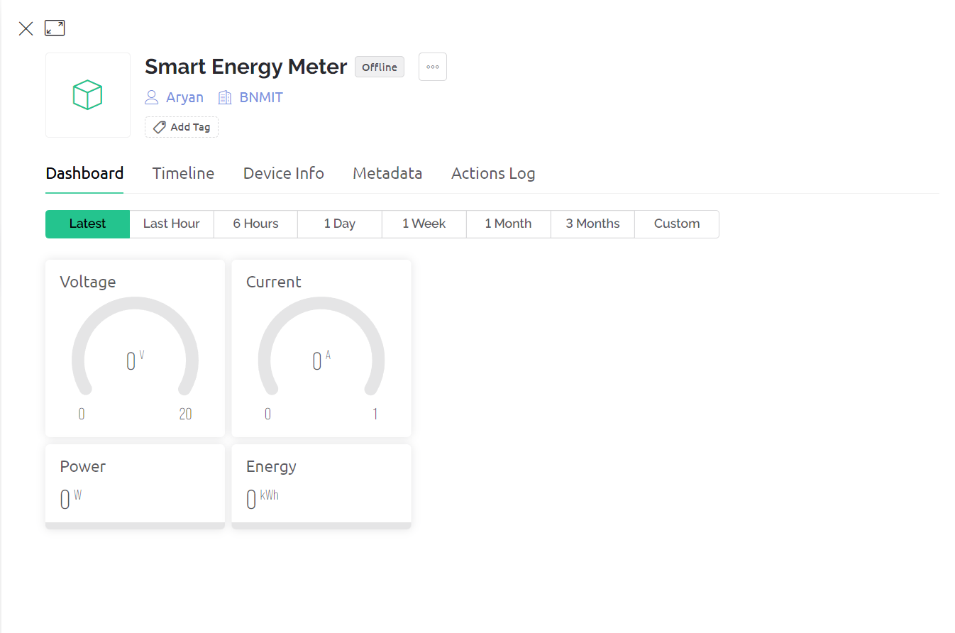
RESULTS AND DISCUSSION
When the device is offline, the readings will be set at 0.

Slide 8
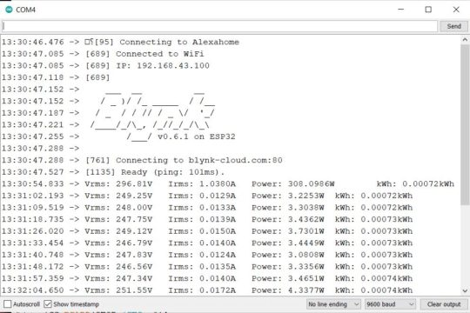
Once the device is made online, the energy meter data is uploaded to Blynk Application after the interval of every 5 seconds. The data can be observed on Serial Monitor as well as Blynk Application.

Slide 9
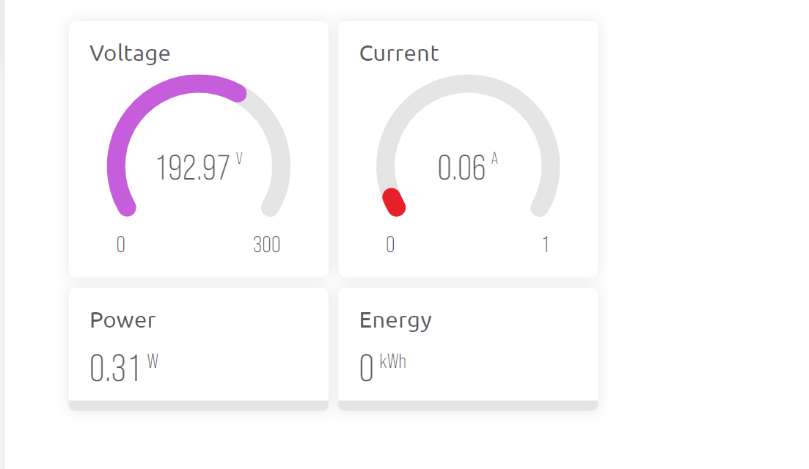
The data is sent to the Blynk Application in real time.

Slide 10
CONCLUSION
The IOT based Smart Energy Meter is the anti-theft detection system.
Even if theft is caught, the victim cannot get back their valuable belongings.
It is easier to stop something happening in the first place than to repair the damage after it has happened.
By using this technique, crime of stealing power may be brought to an end and thereby a new bloom may be expected in the economy of our motherland and also there will be less scarcity for power utilization.

Slide 11
REFERENCES
[1]https://www.researchgate.net/publication/344357016_Internet_of_Things_Based_Electricity_Theft_Detection_Using_Raspberry_PI
[2] https://iopscience.iop.org/article/10.1088/1742-6596/1362/1/012027/meta
[3] https://www.ijert.org/research/smart-energy-meter-and-monitoring-system-using-iot-IJERTCONV8IS14011.pdf
[4] https://www.smart-energy.com/industry-sectors/energy-grid-management/energy-theft-and-fraud-reduction/

